Slide 1

Compiled by :- Rashmi Pote Reference DASH7 Alliance

Slide 2
ISO/IEC 18000-7
The Dash7 Alliance Protocol is based on the ISO/IEC 18000-7
ISO/IEC 18000 is an international standard that describes a series of diverse RFID technologies, each utilizing a unique frequency range.
ISO/IEC 18000-7 describes the parameters for active air interface communications at 433 MHz (2008 - 2009)

Slide 3
DASH7 Alliance Protocol
Active RFID Standard for 433 MHz.
Build on top of asynchronous WSN MAC.
High level functionality optimized for RFID.
Defines full functional RFID tag.
Can be extended to non RFID applications.
Supports Tag to Tag communication.
DASH7 Alliance Protocol is designed to support fixed and mobile nodes that need to upload or retrieve small chunks of information

Slide 4
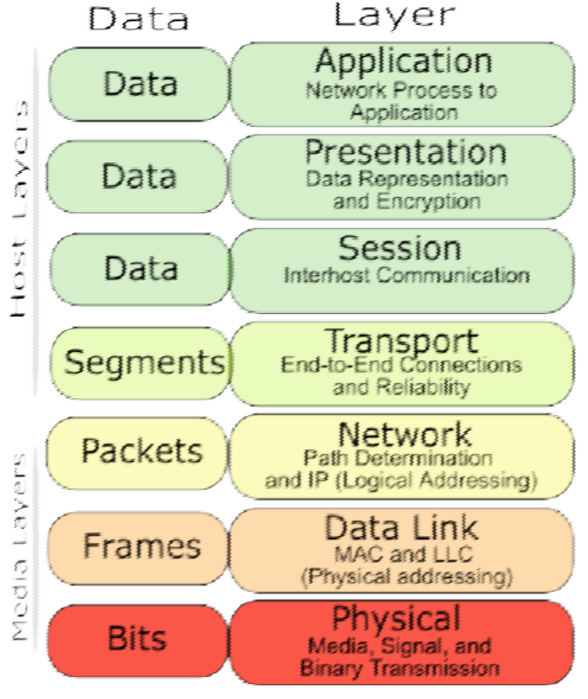
OSI Model
ZigBee WirelessHart ISA100.11a
DASH7 Alliance Protocol
IEEE 802.15.4

Slide 5
Node Types
 | Transmit | Receive | Complete Feature set | Wake-on Scan Cycle | Always-on Receive
Blinker | X
Endpoint | X | X |  | X
Subcontroller | X | X | X | X
Gateway | X | X | X |  | X

Slide 6
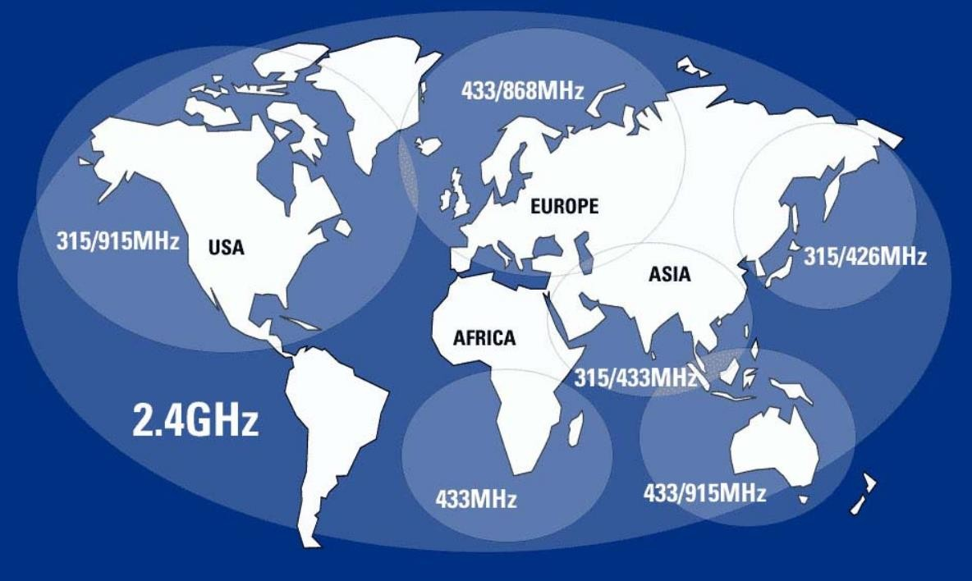
DASH7 band available worldwide

Slide 7
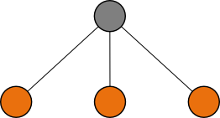
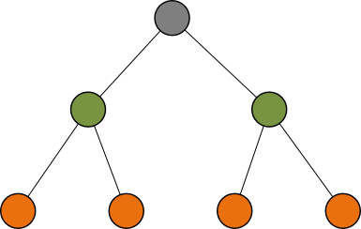
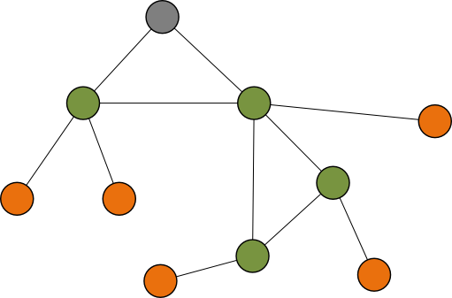




Network Topology
Star
Tree
Mesh

Slide 8
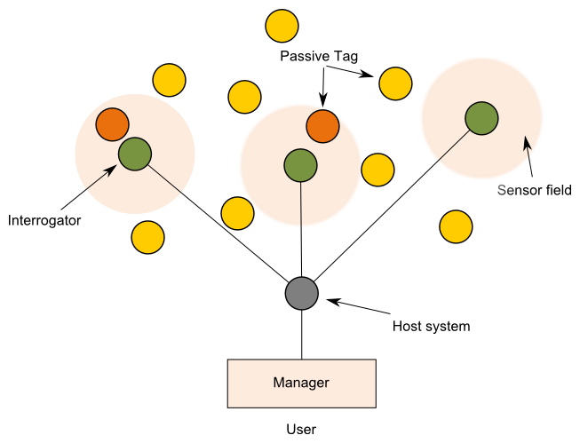
Passive RFID
Tags can only be read in the immediate proximity of a reader

Slide 9
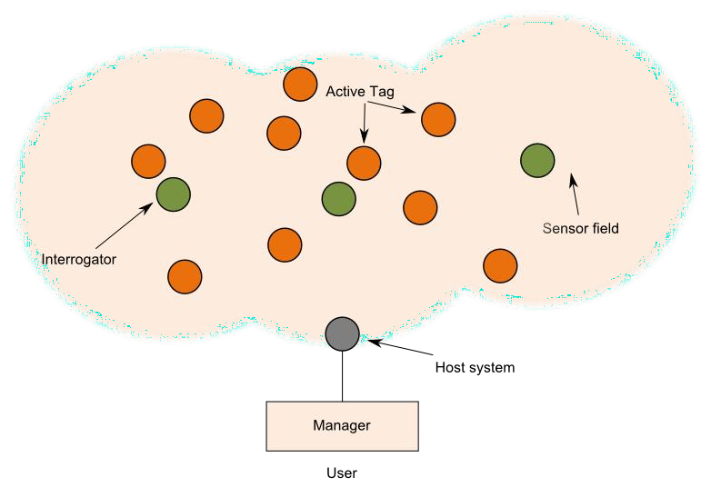
Active RFID
Longer range interrogators - Master/Slave

Slide 10
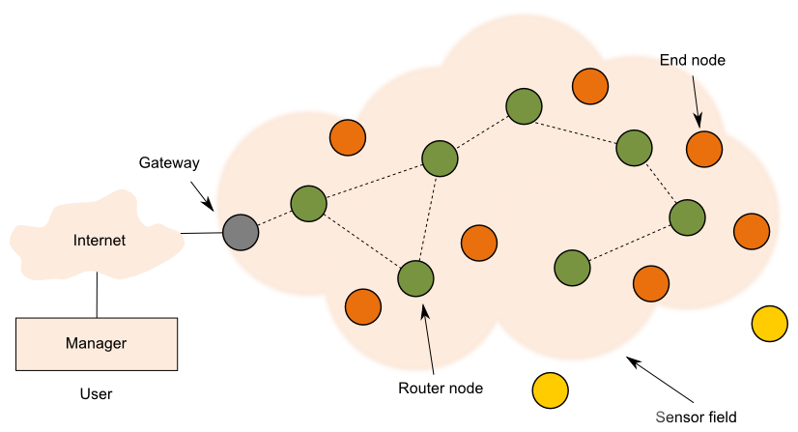
Mesh WSN
Range depends on number of router nodes Congestion - Routing complexity
Latency due to propagation through the network
Routers need to be powered and add to the overall consumption of the system

Slide 11
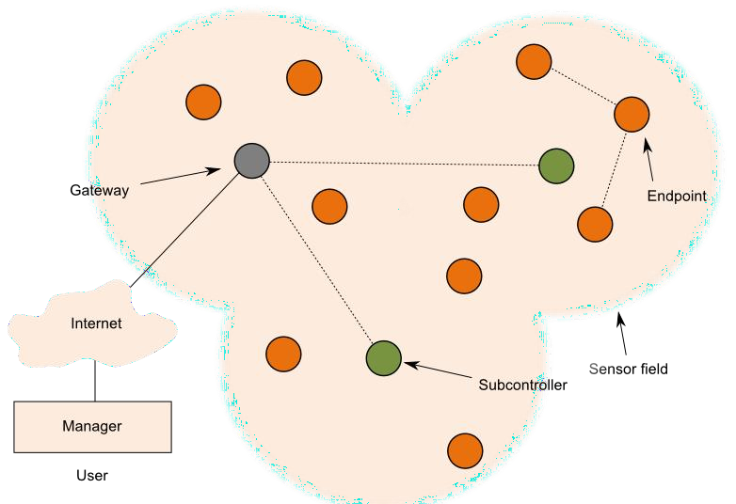
DASH7
Range of Gateway can be extended by subcontrollers
Simple routing (2 hops)
Subcontrollers need to be powered but only a few are needed Tag-2-Tag communication

Slide 12
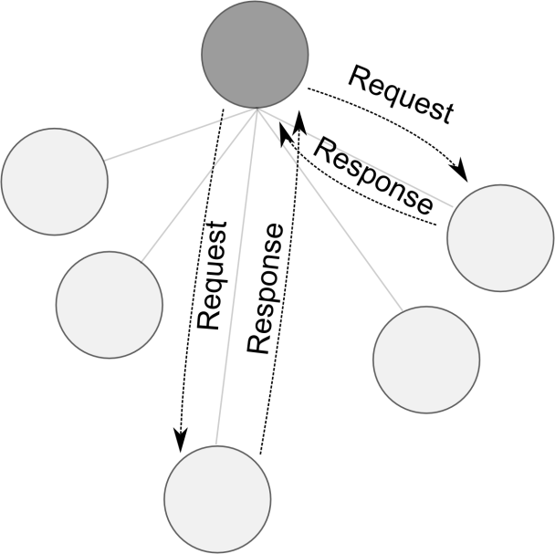
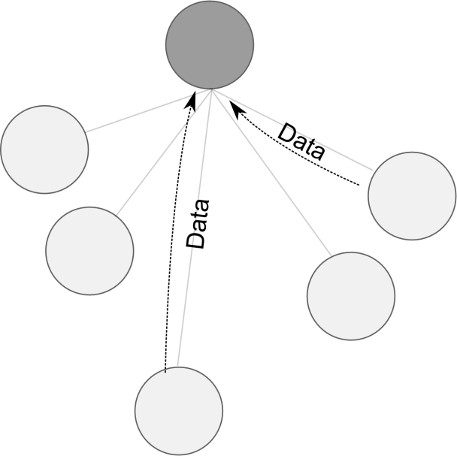
Communication Model
Pull
Push
To obtain spontaneous data
For alarms and periodic data

Slide 13

Low Cost
Large Number Of Nodes
Low Bitrate
Open Standard
Very Low Power
Long
Range
Security Privacy
Reference :-www.dash7.org

